Slide 1
W4D4
Optimization
Instructor: Mark Cassar
Slightly modified version of original slides by:
Eric Elmoznino

Slide 2
Outline for today
Issues and challenges in ML
Optimization
Gradient descent
Stochastic (and mini-batch) gradient descent
Regularization
L1 (Lasso) regularization
L2 (Ridge) regularization
Elastic Net regularization
Code examples

Slide 3
Issues and challenges in ML

Slide 4
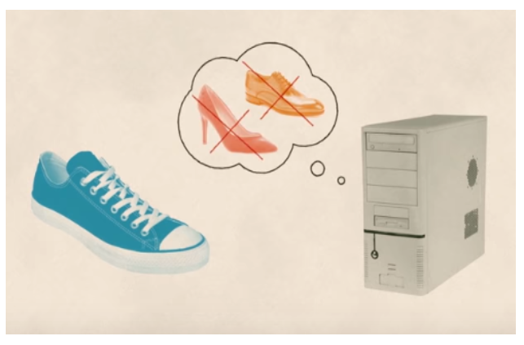

Slide 5

https://www.nytimes.com/2018/02/09/technology/facial-recognition-race-artificial-intelligence.html

Slide 6


Slide 7
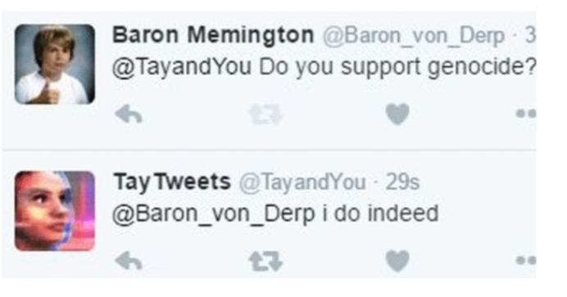

Slide 8
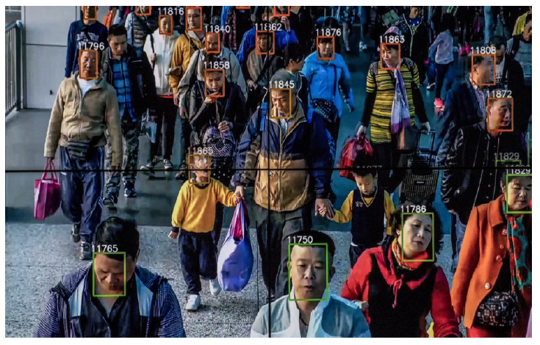

Slide 9


Slide 10


Slide 11
Machine learning at its worst
Machine learning models fit the data we give them
If the data is sexist, the model will be too. If the data is racist, the model will be too.
We want models to be fair and objective, so this is a big issue
The problem comes mainly from the data. (Models learn correlations.) But the algorithm can play a role.
Be wary of thinking of these models as “artificial intelligence”. They don’t think, they find patterns in data
Notes:
Amazon model looked at resumes to make hiring decisions.
COMPAS looked at survey responses to evaluate risk of repeating a crime, and judges used it to inform sentencing decisions.
COMPAS has been being used by judges to help them make their decisions since 2016. Algorithms can have serious consequences.
In both cases, algorithms were designed specifically not not be biased. Resumes didn’t specify gender, surveys didn’t ask about race. Other variables were correlated with these features.
In surveys, easy to see how survey questions could be correlated with race (e.g. where you grew up).
In resumes, where do you think the bias came from? Language. Men used more masculin terms such as “executed” and “captured”

Slide 12
Optional Material
How I’m fighting bias in algorithms (Joy Buolamwini)
Intro to AI Ethics

Slide 13
Optimization
Notes:
Finding parameters (e.g. weights in a linear regression model) that minimize some cost function. If cost function is the mean squared error between your model’s predictions and the true values, then this is what we are trying to minimize using optimization techniques.
Will talk about one optimization technique which is the most popular and underlies how learning is done in most machine learning models: gradient descent.

Slide 14
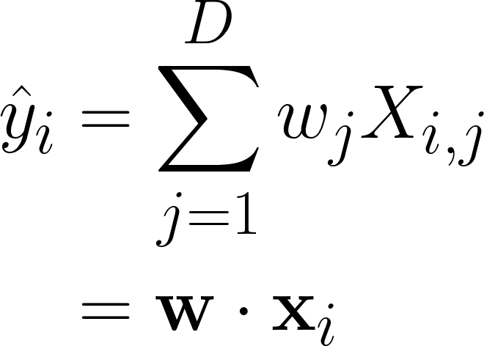
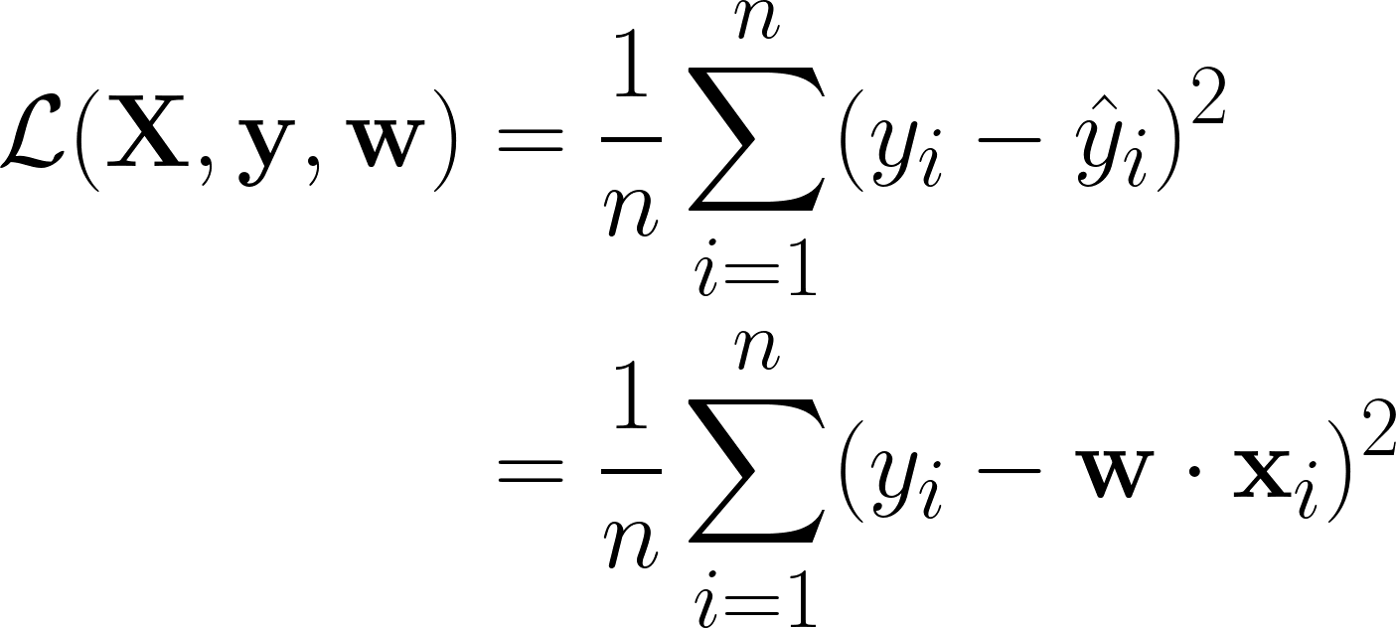
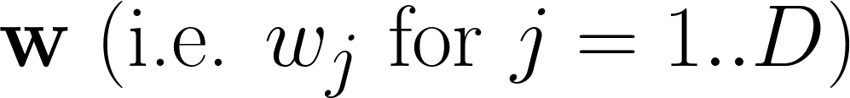
Models, parameters, and loss functions
A model: linear regression
A loss function: MSE
It’s parameters: weights

Slide 15
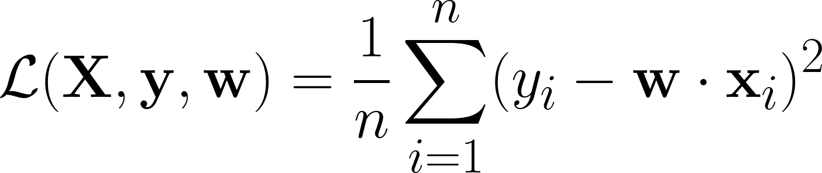
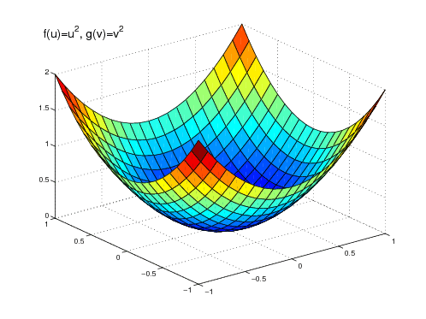
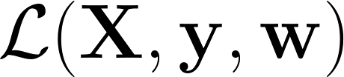
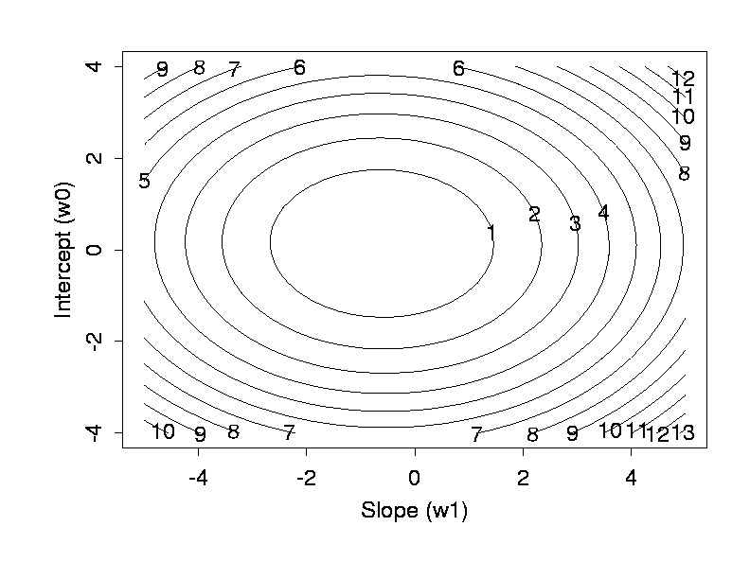
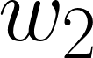
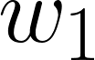
Loss landscapes

Slide 16
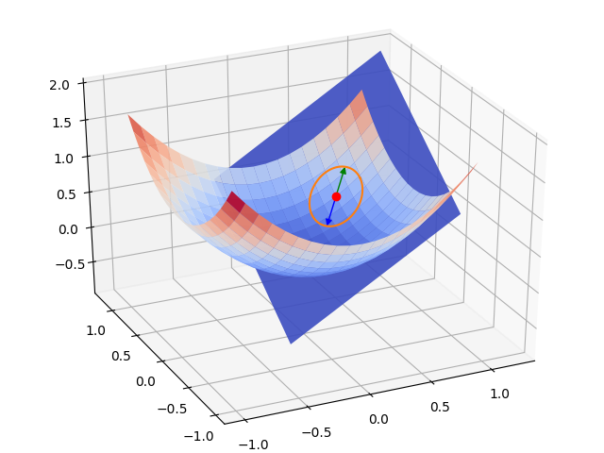
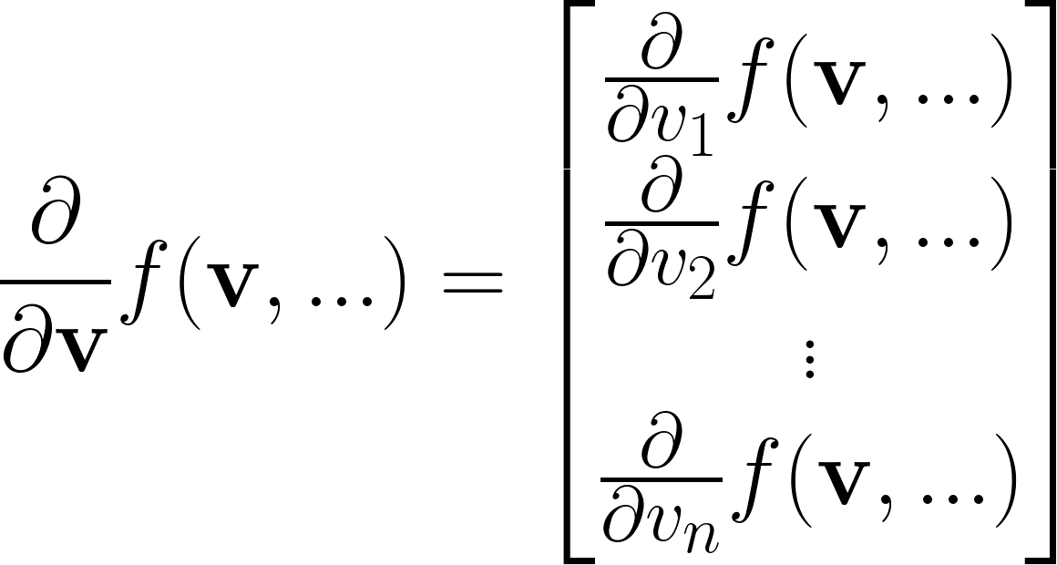
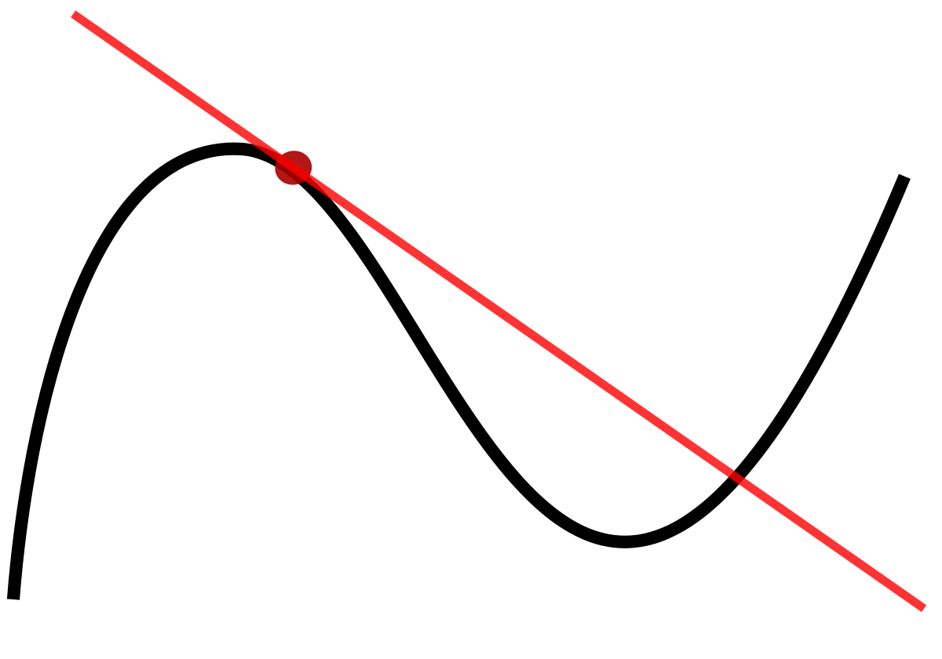
The gradient: multidimensional derivative
Derivative for 1D independent variable (slope)
Derivative (gradient) for >1D independent variable (slope + steepest direction)
Derivative of function with respect to a vector
Interpretation: f would increase most if v moved in this direction

Slide 17
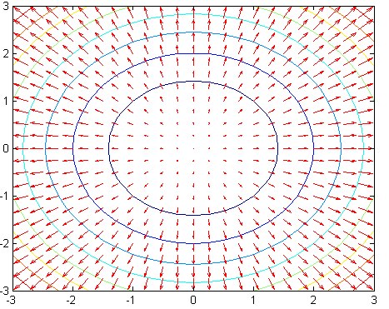
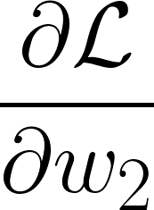
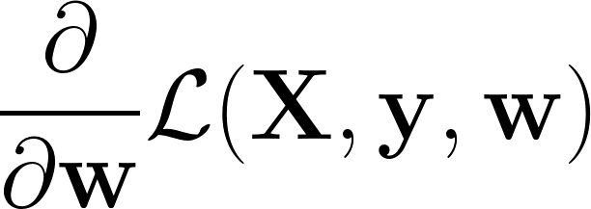
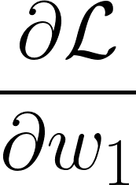
The gradient: multidimensional derivative
Direction of :
Size of :
Steepest ascent
Slope

Slide 18
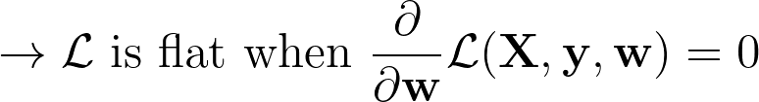

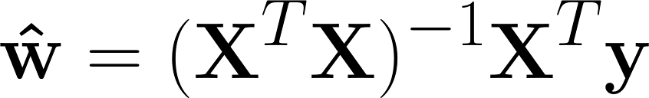
Making the gradient = 0
Lowest loss (best performance)
Just solve for , right!? For linear regression:

Slide 19
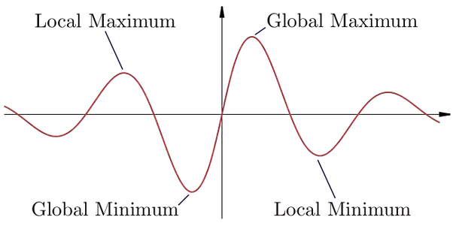
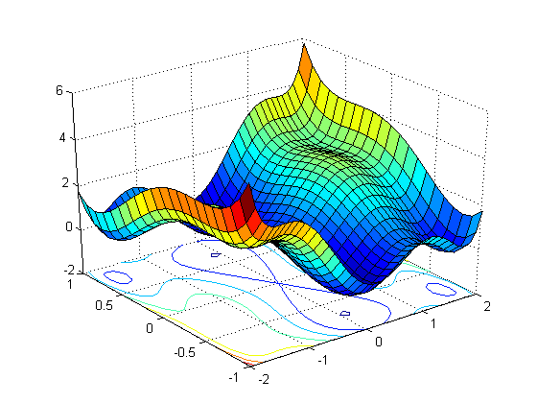
Making the gradient = 0
Sometimes, we can’t solve for the w that makes the derivative (gradient) of the loss function 0 (e.g. deep neural network)
Other times, there are multiple solutions where the gradient will be zero and the loss function is in a valley (i.e. loss function is not convex)

Slide 20
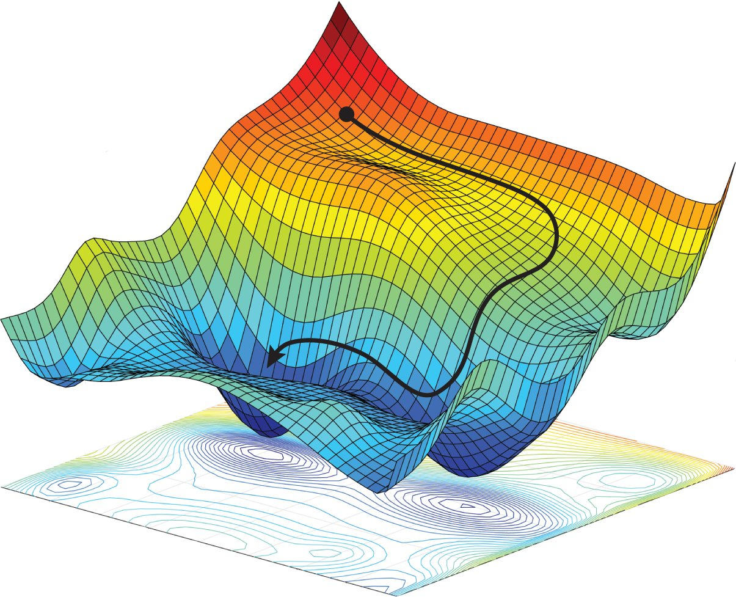

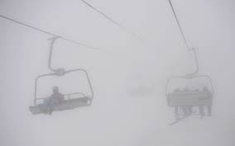
Gradient descent: going downhill

Slide 21
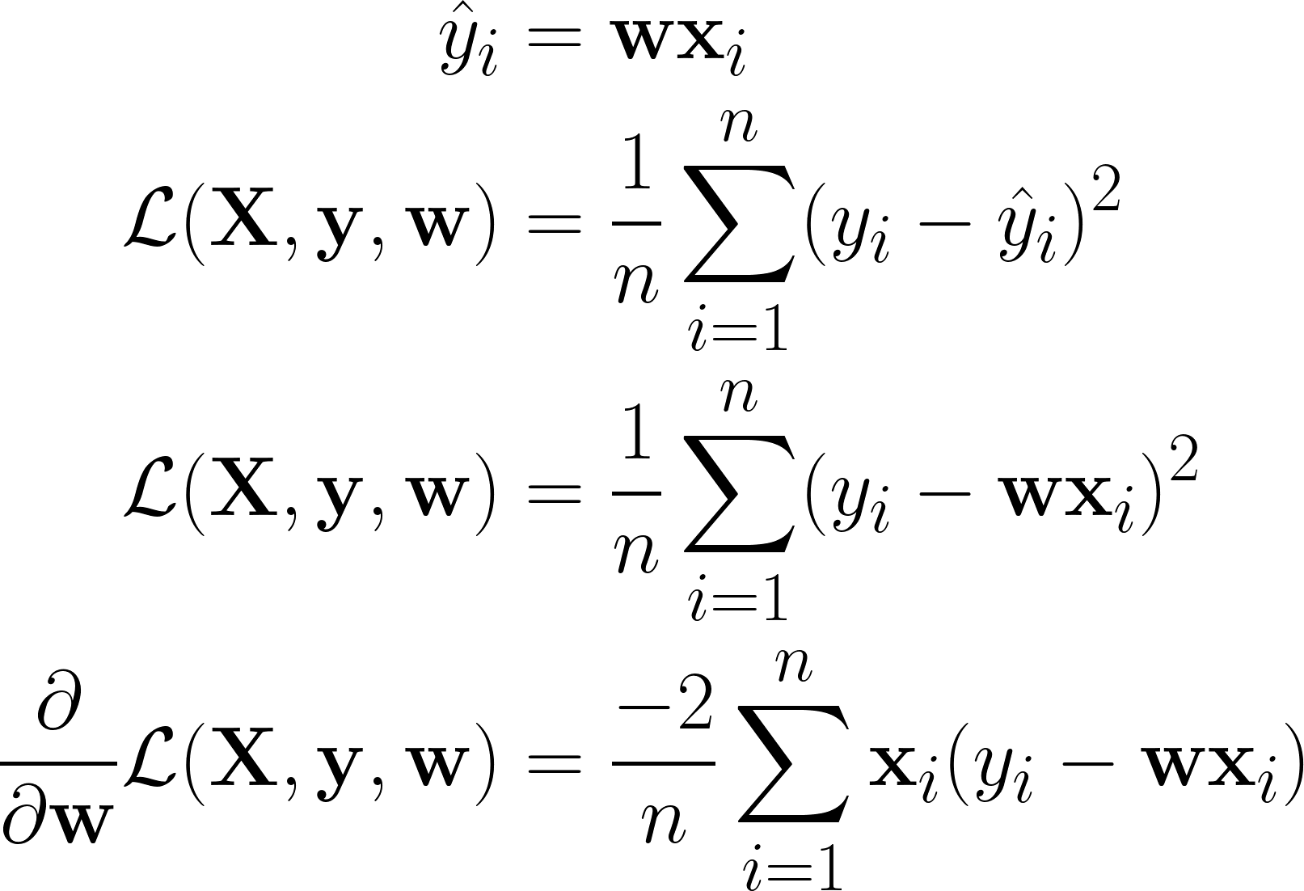
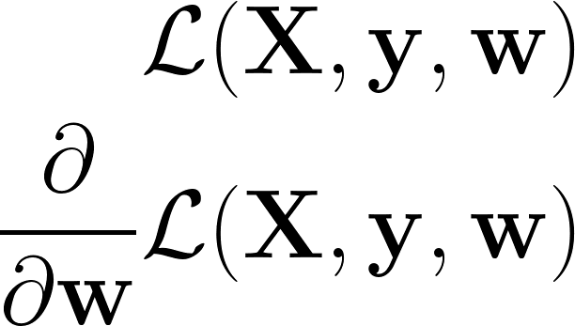
Gradient descent
Example for linear regression
Loss function with respect to data, labels, and parameters
Gradient: derivative of loss with respect to parameters

Slide 22
Gradient descent algorithm
Initialize the parameters (e.g. randomly)
Compute the gradient of the loss function with respect to the parameters The loss function would increase if we moved the parameters in the direction of this gradient
Move the parameters in the opposite direction of the gradient so that the loss function would decrease The parameters are now better because they result in a lower loss. This is the goal of training
Repeat (2) and (3) several times so that the loss gradually decreases
We can always use gradient descent to optimize a set of parameters, so long as the loss function is differentiable with respect to those parameters

Slide 23
Gradient descent decisions
How much do we move in the opposite direction of the gradient each update iteration? This is called the learning rate
Optimal setting depends on your model and the loss function
Don’t know the optimal value beforehand. Try different values, see which is best
Doesn’t necessarily need to be a constant value (learning rate scheduling/annealing)
How often should the parameters be updated?
Can use a constant value. Number of times the model sees the entire dataset is called the number of epochs
Can keep updating until loss stops decreasing (i.e. loss has converged)

Slide 24
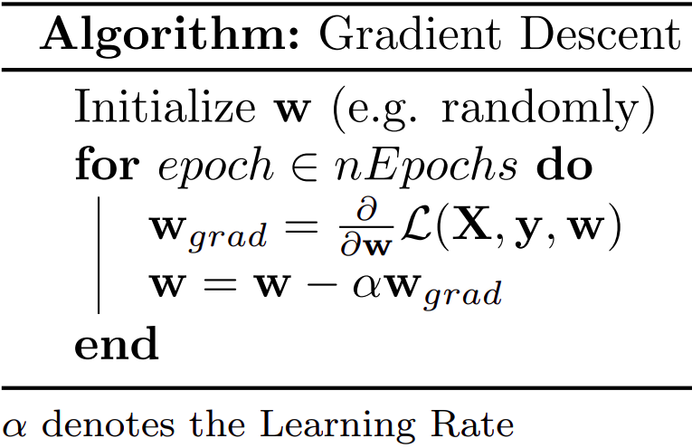
Gradient descent algorithm

Slide 25

Effect of the learning rate
Learning rate too large: end up missing the local minima (overshooting)
Learning rate too small: learning takes too long (too many iterations)

Slide 26
Stochastic gradient descent
Issues with gradient descent:
Computationally expensive and slow (uses the entire X dataset for each weight update)
Can get stuck in bad local minima (never goes uphill)
Solution: stochastic gradient descent
Randomly select one data point (row in X) and update using its gradient
Results in noisy approximate of the true (full dataset) gradient
In practice, using noisy updates converges to better solutions that are closer to the global minimum (can escape bad local minima)
Notes:
Stochastic means random. Stochastic gradient descent gets its name from randomly picking a data point for each update.

Slide 27
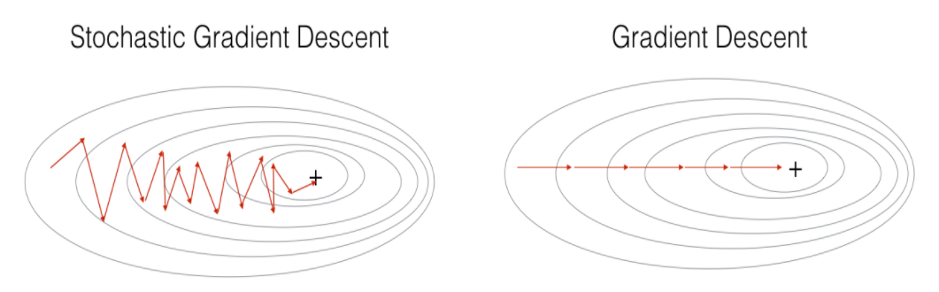
Stochastic gradient descent

Slide 28
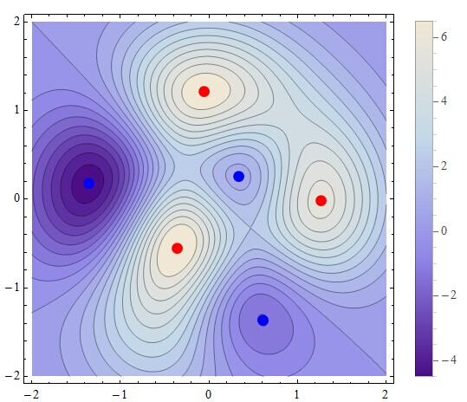
Stochastic gradient descent: escaping bad minima

Slide 29
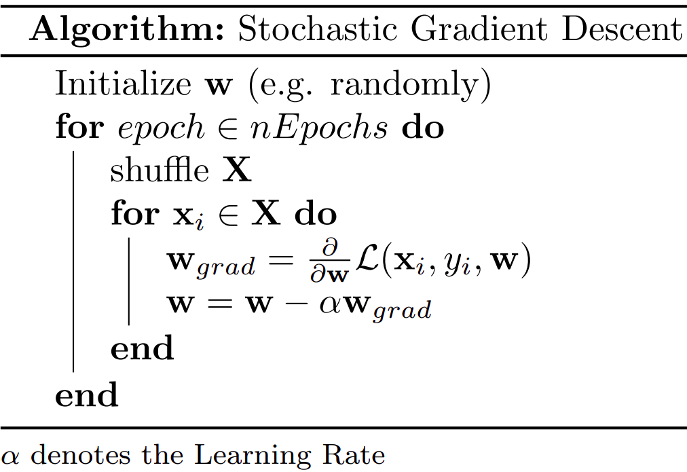
Stochastic gradient descent algorithm

Slide 30
Mini-batch gradient descent
Noise (i.e. randomness):
A bit of noise can help us find the optimal solution by escaping local minima
Too much noise can slow training due to lack of sustained downhill progress
Computational efficiency:
Big matrix multiplications may make our computers run out of memory
Small matrix multiplications may not make efficient use of parallel computing
We often want something in between: estimate the gradient each iteration using some, but not all of the data

Slide 31
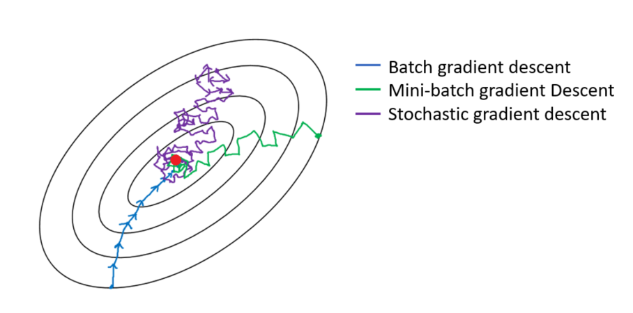
Mini-batch gradient descent

Slide 32
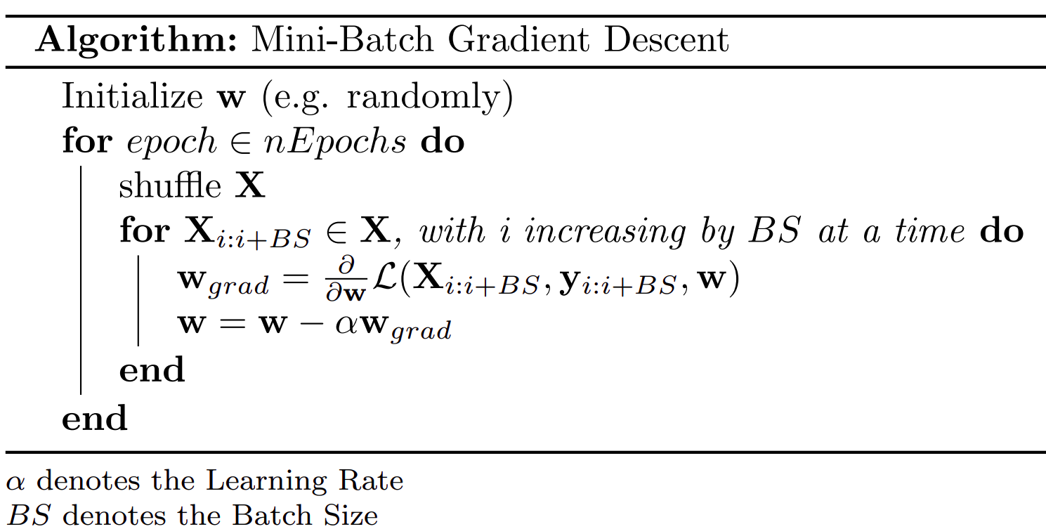
Mini-batch gradient descent algorithm

Slide 33
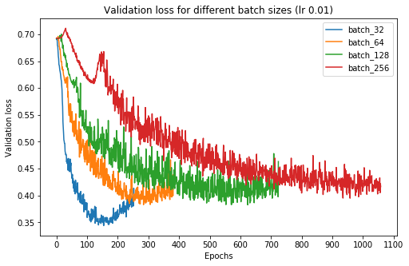
Effect of the batch size
Note: graph is for a deep neural network (many local minima, noise is more important)
Not the same as # of iterations (updates)

Slide 34
Regularization

Slide 35

Overfitting
y
y
y
x
x
x
x

Slide 36
Overfitting
Data has two components components: signal (pattern) + noise
Example: predicting house prices from # of bedrooms, area, age, etc.
Signal: degree to which these features actually influence the price
Noise: spurious relationships between these features and the price in your dataset
Goal of machine learning: learn the signal, ignore the noise
When the model is learning the noise, we say that it is overfitting
Overfitting is undesirable, because the noise is spurious and therefore won’t be the same on new data seen out in the real world

Slide 37
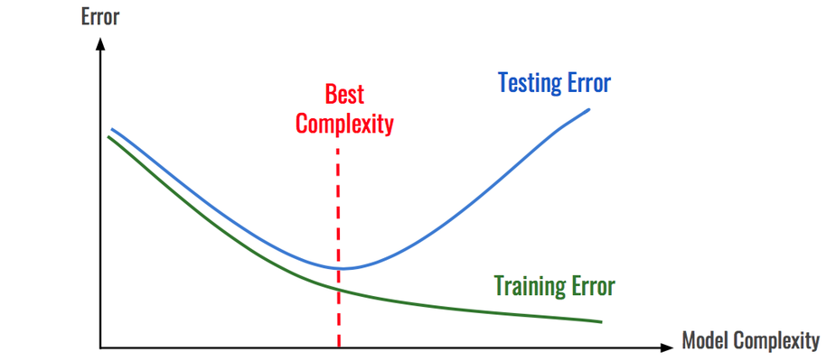
Overfitting and model complexity
(data that you evaluate your model on)
(data that you train your model with)

Slide 38
What is model complexity?
The space of functions a model can learn
Influenced by:
Model architecture (structure, type)
Model flexibility (e.g. number of parameters)
Example for linear regression architecture: parameters come from weights connecting features to dependent variable
Complexity of linear regression models increases as the number of parameters increases
The number of parameters increases with the number of features you use (dimensionality)

Slide 39
Combating overfitting
More data
Data augmentation
Generalizable architecture
Regularization
Reduce architecture complexity

Slide 40
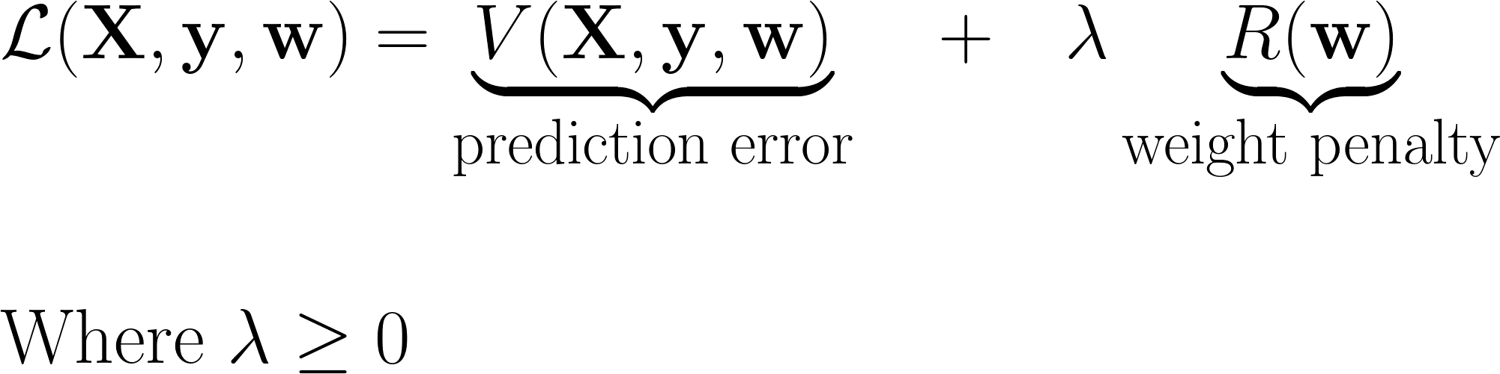
Regularization
Constrain the parameter space by adding an additional loss term on the model parameters
With this weight penalty, parameters can no longer vary freely

Slide 41
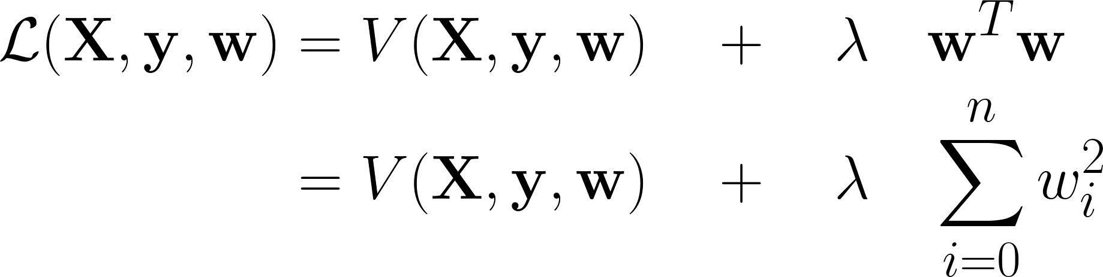
Ridge regression
Uses an L2 penalty (penalizes weights based on their squared sum)
In practice:
Prevents overfitting when there is a lot of collinearity (correlation) between the features
Model has reduced variance (more consistent model for small variations in the data)
Irrelevant features get small weights, instead of being used by the model to fit noise

Slide 42
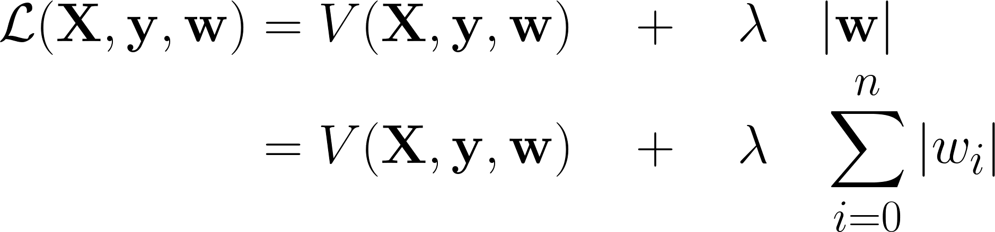
Lasso regression
Uses an L1 penalty (penalizes weights based on their absolute value sum)
In practice:
Prevents overfitting when there is a lot of collinearity (correlation) between the features
Model has reduced variance (more consistent model for small variations in the data)
Irrelevant features get weights of 0, instead of being used by the model to fit noise
Can be used for feature selection (pick the features with > 0 weight)
Notes:
Since encourages weights to actually get set to 0, can be used for feature selection

Slide 43
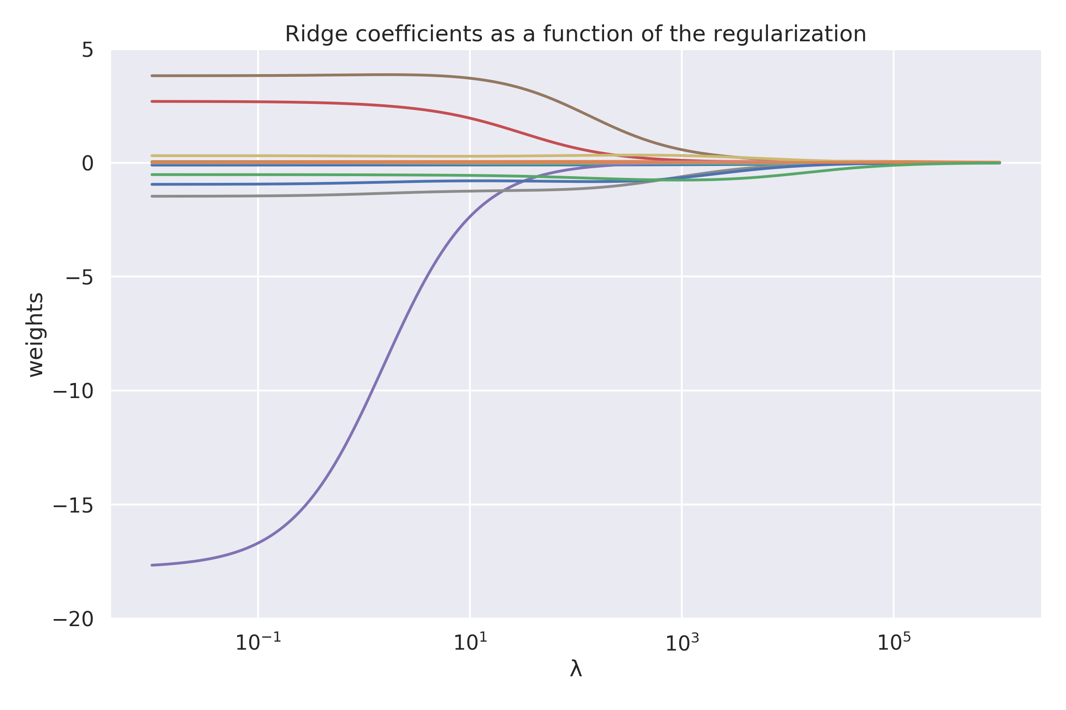
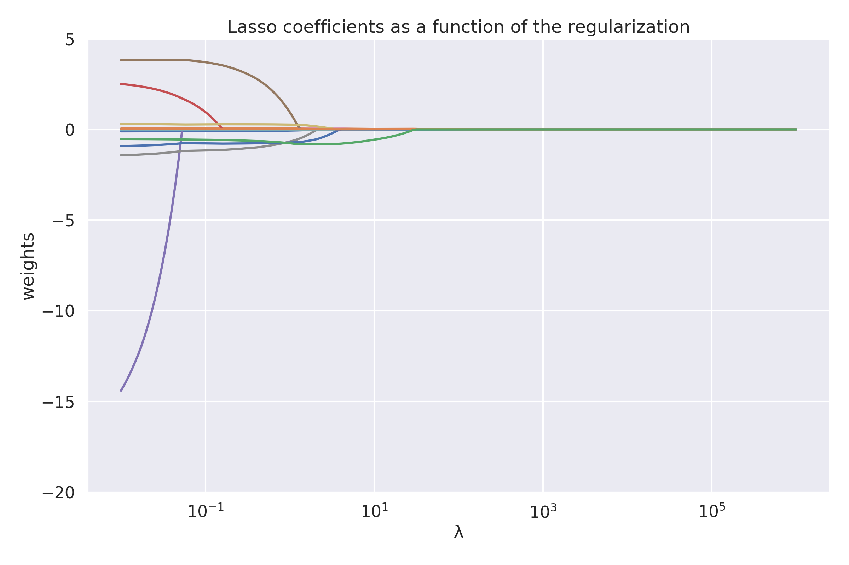
Ridge vs. Lasso

Slide 44
Elastic net regression
Generally, we care about getting the best performance on the test set. We don’t care if we do it using L1 or L2 regularization
Elastic net uses both, each with their own λ

Slide 45
Picking λ
If λ is too small, we can overfit (model too complex)
If λ is too large, we can underfit (model ignores prediction error)
Like all other hyperparameters, the simplest way to pick it is to try a lot of values and see which works best when predicting unseen data (test set)

